Slide 1
Nba subreddit scraping
Can we predict the subreddit post depending on just a word????
Analysis by omar carr
Lake show enterprises

Slide 2

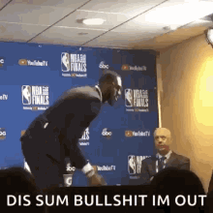
The king has everyone talking
The summer of 2018 has shown that the NBA is still one of the most popular professional sports in the world. All clamored to find out what the “self described King” Lebron James would move to this year. Would he stay in Cleveland? Would he leave for the lights of Tinseltown? Or would he venture to another NBA city and stake his claim as the GOAT there?
Social media was buzzing and Reddit threads were no different.

Slide 3
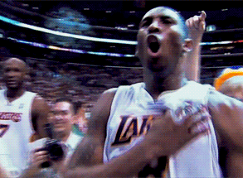
What can lake show enterprises do for you
Our job is to make sure that as a sports marketing firm, you understand what the talk is about and where YOU can put focus on depending on the predicted subreddit post.
You should have every advantage possible to reach the proper consumers

Slide 4
How does it work?
We start by scraping three subreddits just to show where Lebron’s effect may carry.
r/NBA
r/Lakers
r/ClevelandCavs

Slide 5
Anything interesting
815 posts for Lakers
754 posts for Cavs
762 posts for NBA
33% NBA, 35% Lakers, 32% Cavs (fairly balanced)

Slide 6
Scoring
Our initial model with Count Vectorizer and Multinomial Naïve Bayes gave us 94.2% on our Training Data, and 80.4% on our Testing Data
When removing ‘English’ stop words, we learned:
‘lebron’ was used 237 times with 112 total in Cavs reddit, 80 in the Lakers
‘game’ was used 114 times with 53 total in NBA reddit
‘season’ was used 110 times with 51 total in Lakers reddit
Surprisingly, ‘magic’ was used 21 times, 10 in NBA reddit, and 8 in Lakers reddit

Slide 7
Scoring (con’t)
Very overfit
After removing stop words and using Count Vectorized X (train and test), top 4 scores:
Multinomial Naïve Bayes – Train 93.82%, Test 80.45%
Logistic Regression CV - Train 99.03%, Test 78.22%
Gradient Boosting – Train 82.27%, Test 74.79%
Extra Trees – Train 99.77%, Test 74.27%

Slide 8
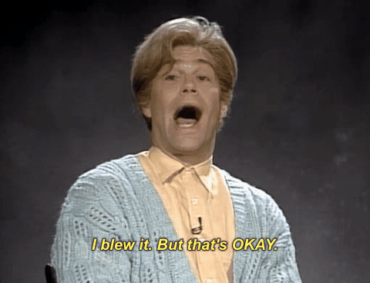
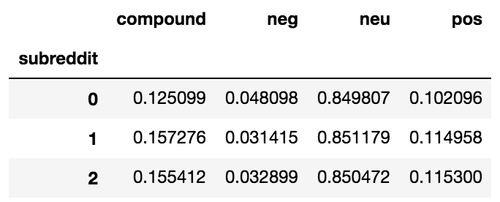
The Stuart smalley sensitivity rate
Overall, the posts tend to be pretty neutral, but more negatively in the NBA reddit, and slight edge in the Cavs reddit even after Lebron left

Slide 9

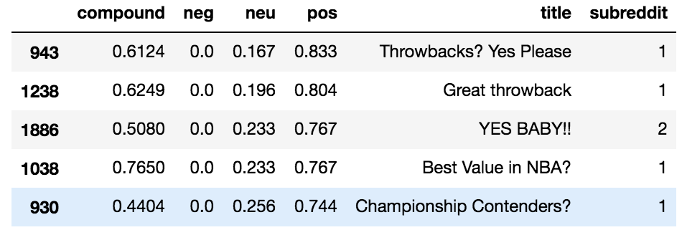
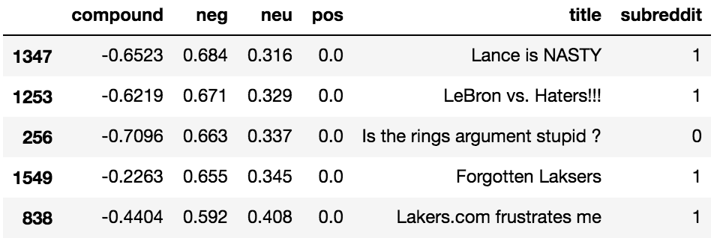
The Stuart smalley sensitivity rate (CON’t)
Positive
Negative

Slide 10

Can we improve it?
Increasing the n-gram to (1,2) and the min_df to 2.0 on the CountVectorizer side caused our Training score to decrease, but our Test score increased.
Taking the above change and changing the alpha in MultinomialNB to 2.0 causes our Training score to slightly decrease again, but our Test score stayed the same.

Slide 11
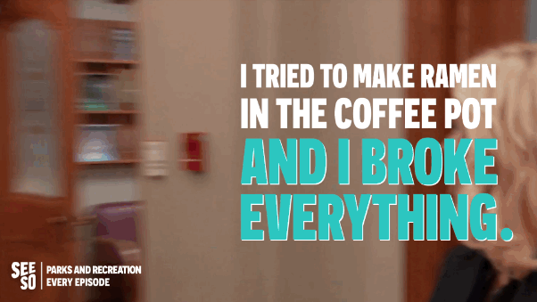
Room for improvement
Our final score was 89.87% on the Training, and 81.99% on the Test
There is lot that could be done better. A 3 reddit chase was “ambitious” at best
EDA was not great, need to improve on using Feature Union with the Pipeline
Were there any duplicates, did I truly get only the words? Could we remove misspelled words?

